Slide 1

Rhythm Jo
조영제 1761803 김규연 1690008

Slide 2
WHY?

Slide 3
HOW?

Slide 4
WHAT?

Slide 5
BEAT
RHYTHM JO
MACHINE

Slide 6
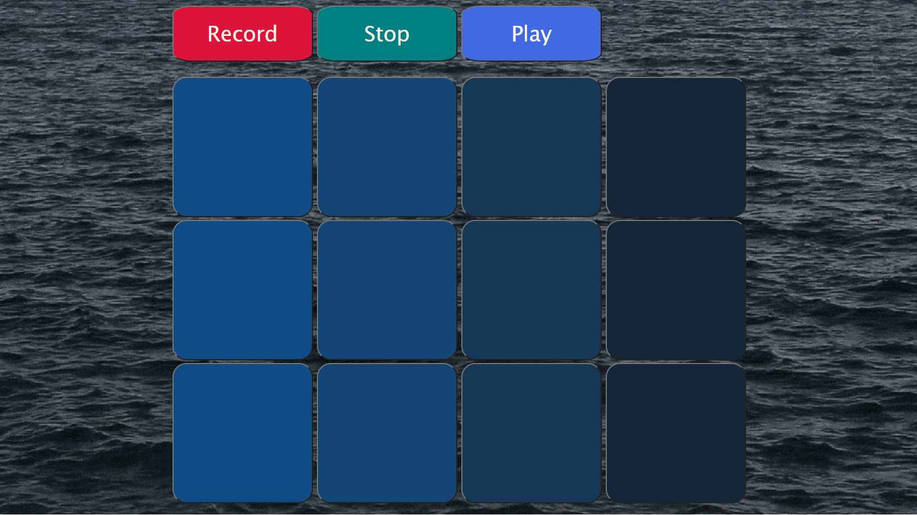

Slide 7
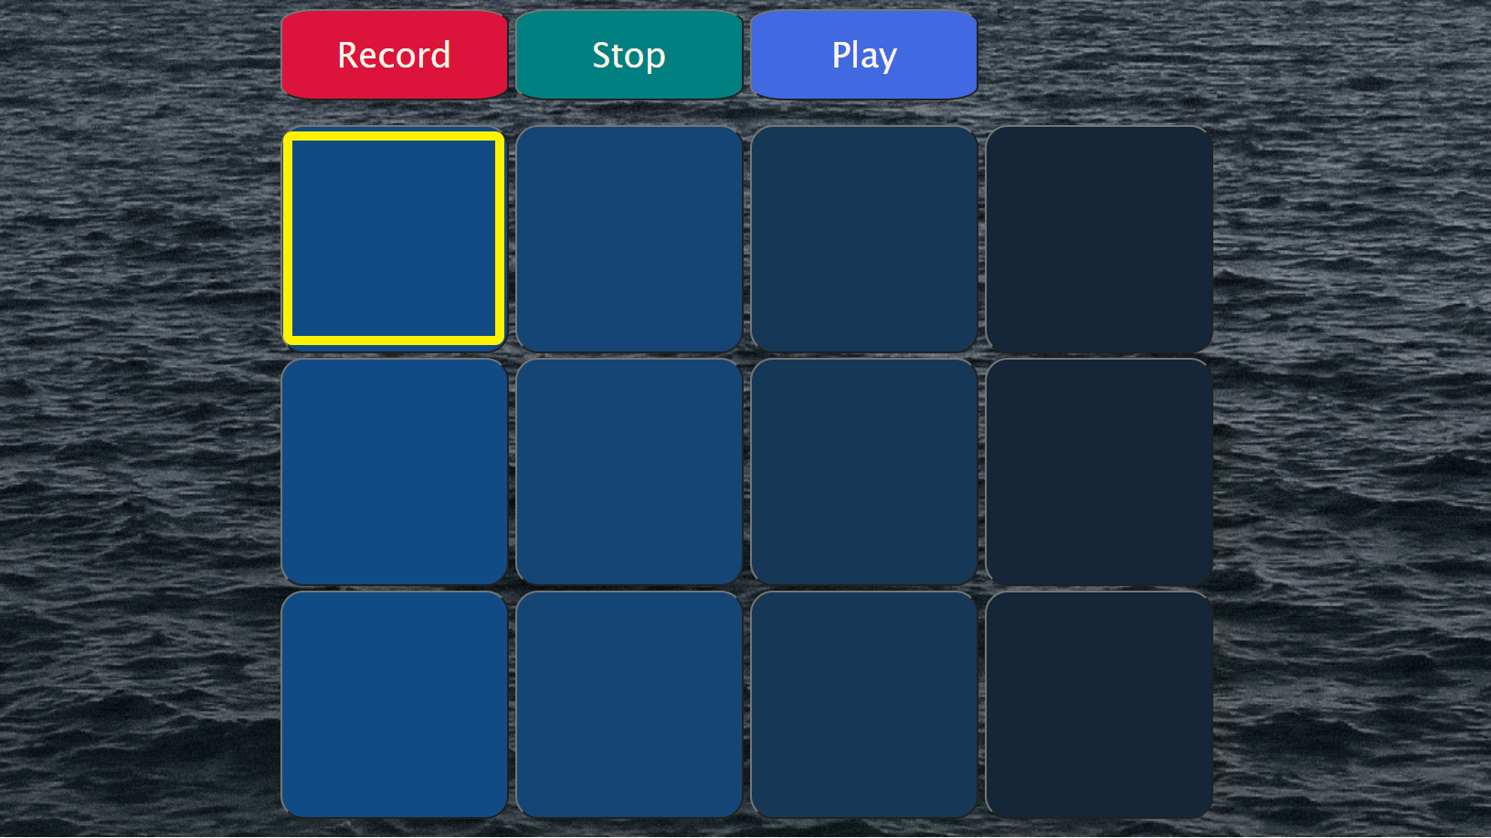

Slide 8
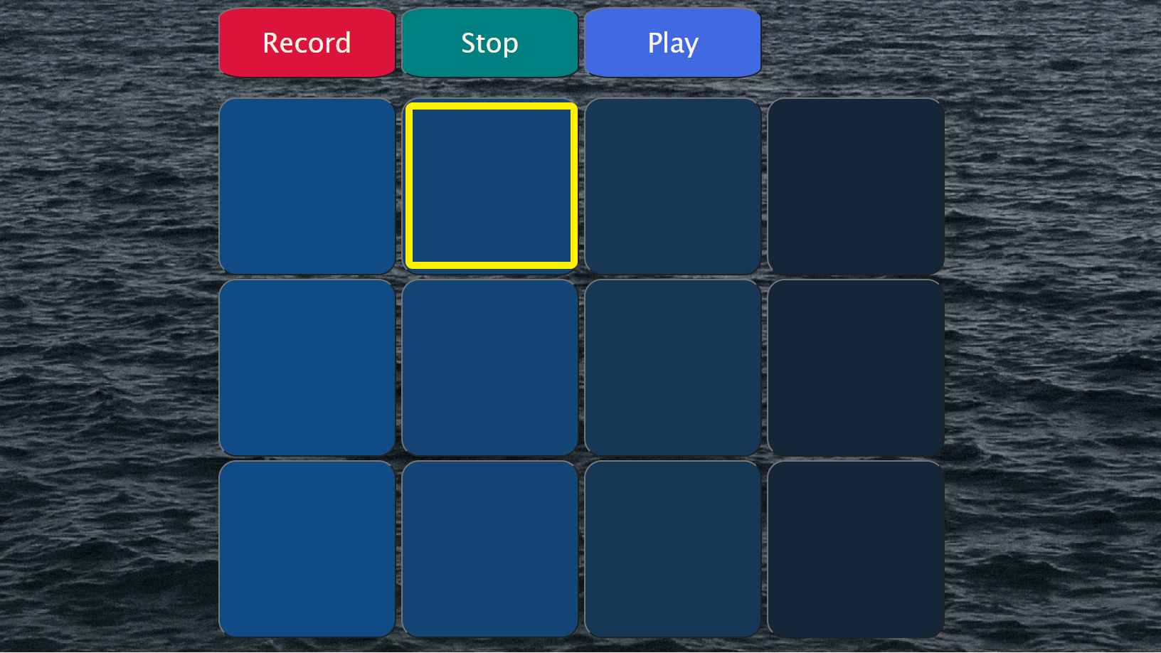

Slide 9
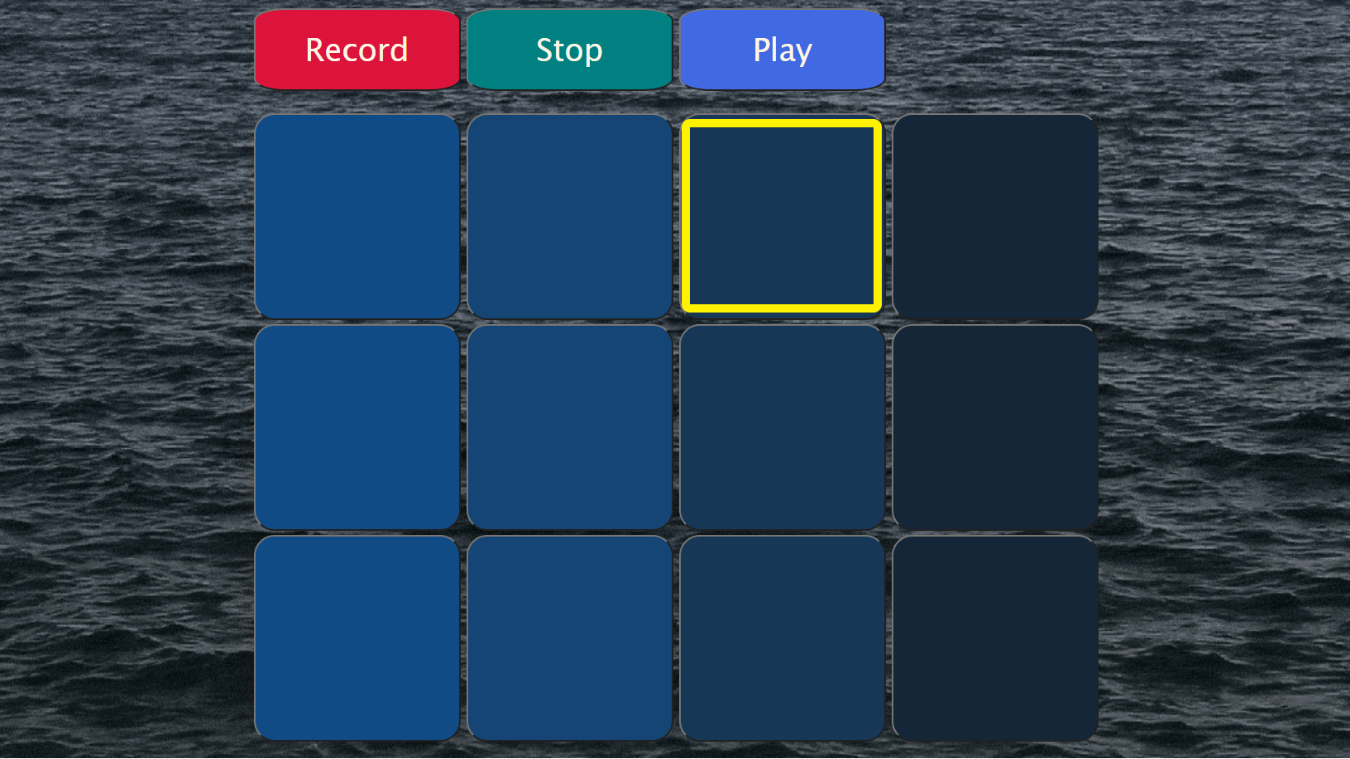

Slide 10
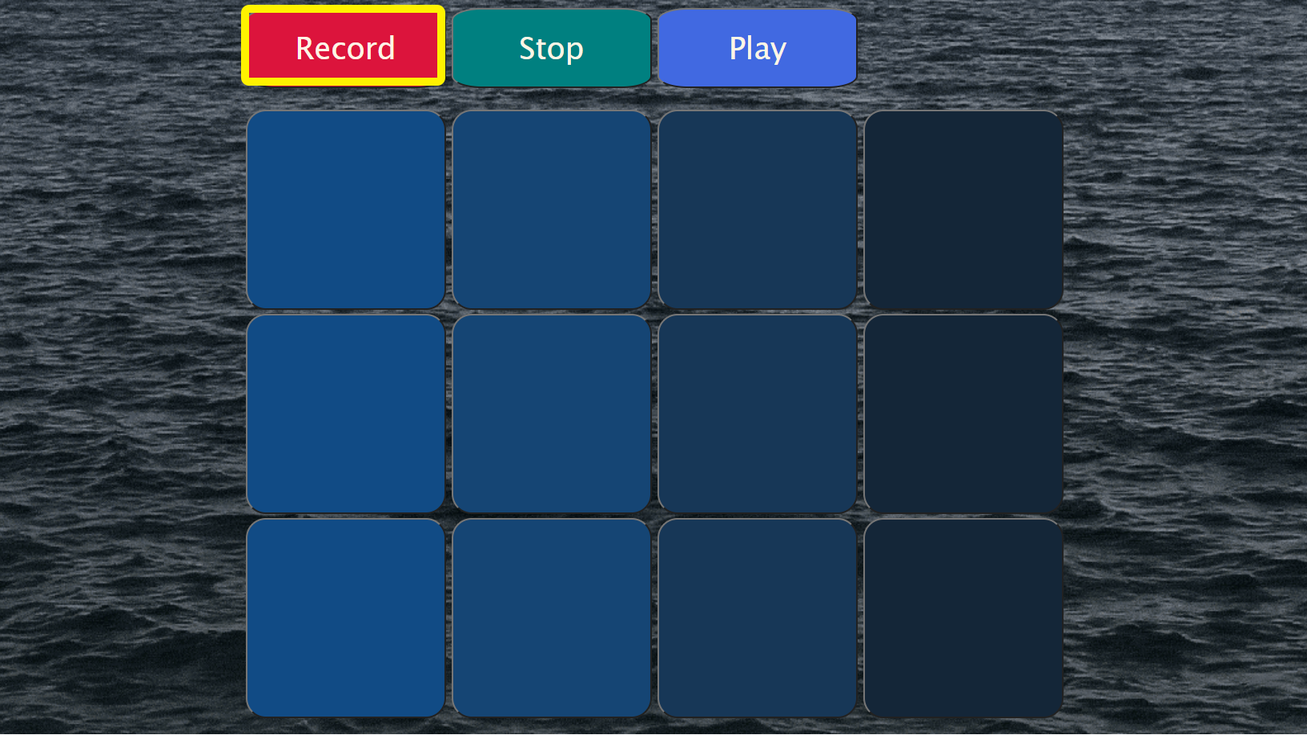

Slide 11
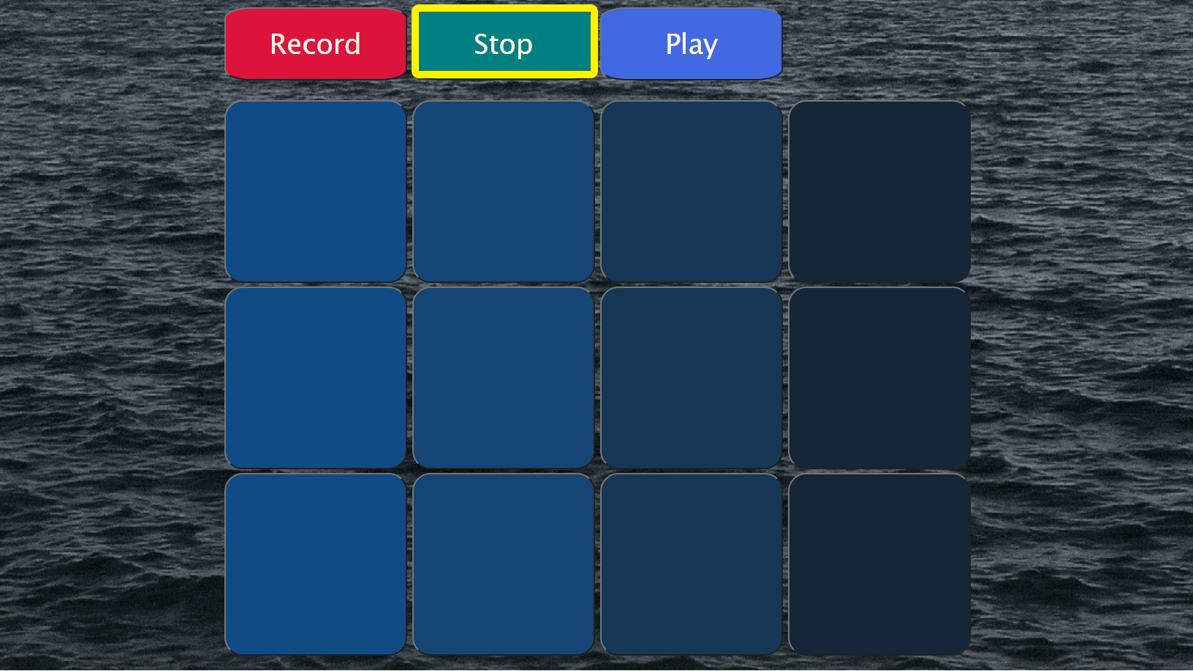

Slide 12
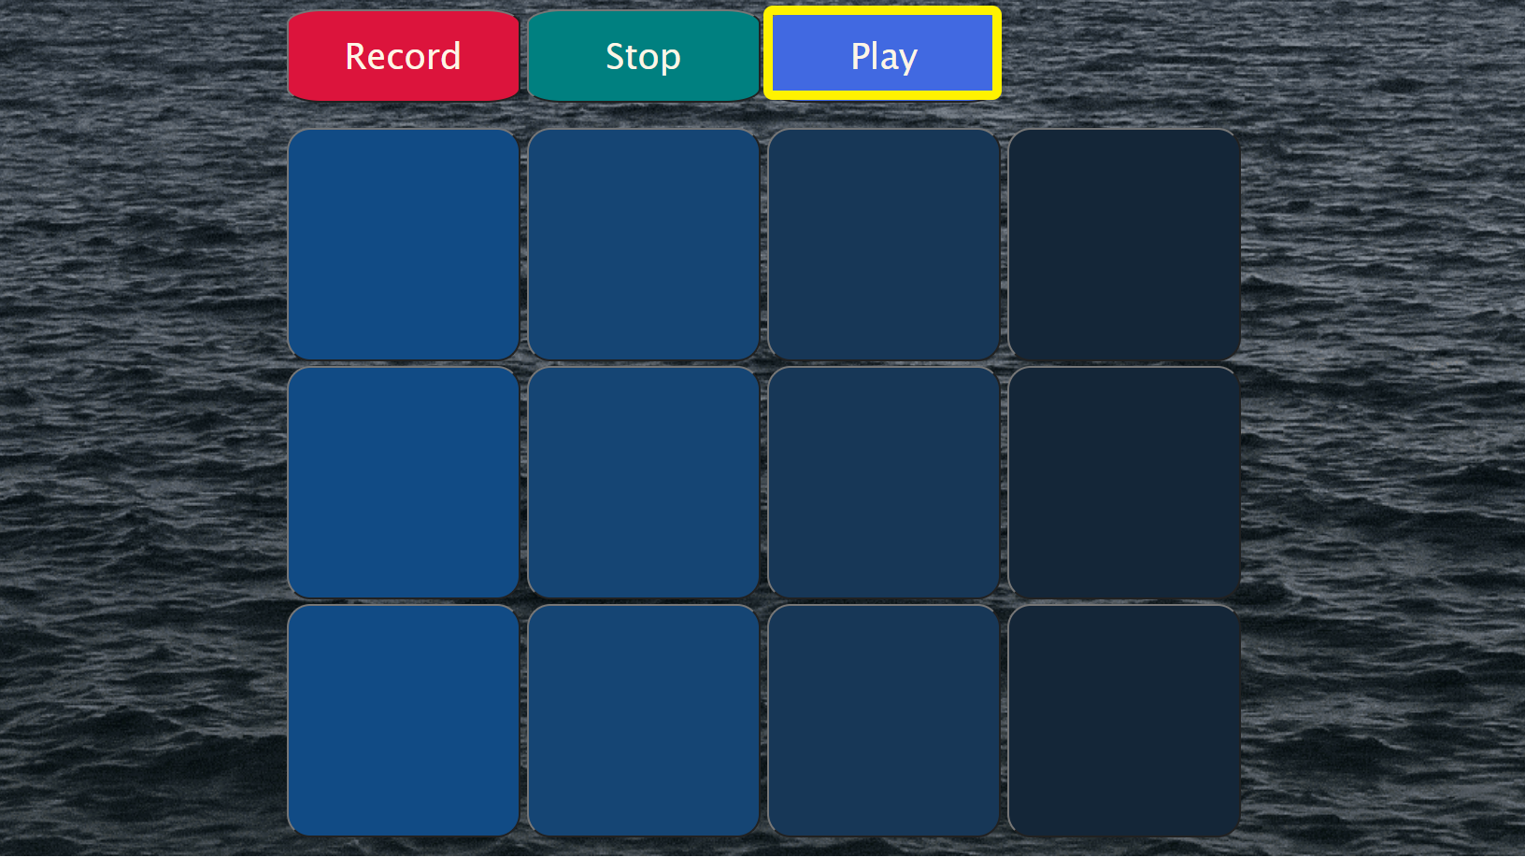

Slide 13
마치며..

Slide 14
THANK YOU♥

